Slide 1
FullStack Website
MINI PROJECT II
SESSION:2020-21

Slide 2
Group Members
Nikhil Baghel (181500424) Section-E
Mentor: Amir Khan Sir

Slide 3
Objective
The objective is to build a Ecommerce Website in which we implement all the concept of Fullstack Technology like HTML, CSS, Bootstrap and JavaScript , SQL , PHP.

Slide 4
About this project
Online shopping is the process whereby consumers directly buy goods and services without any intermediary service over the internet. In this project, We have build a E-Commerce Website “LifeStyle Store” for purchasing lifestyle items and merchandise according to people’s interest. It is actually a website of the daily lifestyle things. It has following pages.
Index page
Signup page
Login page
Logout page
Product page
Cart page
Setting page
Success page

Slide 5
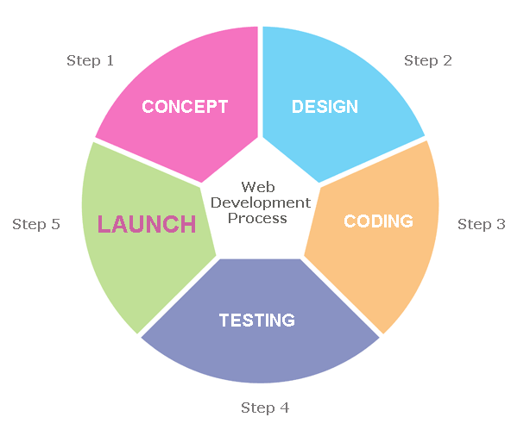
This figure showing the different steps involved in Web development process

Slide 6
Software and Hardware Requirements
Hardware : PC or Laptop containing (i3 processor or above), RAM 4GB or more and Hard Disk 500GB or above)
Software: Window 7/8/10
VS code
Github
Google chrome

Slide 7
Technology Used
HTML : It is used by developers to define structure of the webpage. Every page you see on browser is written using HTML. Web-Browser read and understand the markup text in HTML.
CSS : CSS stands for Cascading Style Sheets. To define style of the Web Page that is, type of font, its size, background-color etc. ,we use CSS. Using CSS, you can define, how each element of your web-page should look. Browser read HTML and CSS together to define the web page.

Slide 8
Bootstrap : Bootstrap is like external CSS file that we will link to our HTML page to apply various styles. We use Bootstrap, we don’t have to write style statements again and again. Bootstrap has various pre-defined CSS classes. We just need to include the name of the class and the style gets applied . This makes web development easier.
JavaScript : JavaScript is a client-side scripting language of web developed by Netscape in 1995 with the name LiveScript. JavaScript is used to build interactive websites with dynamic features and to validate form data. JavaScript is high-level, dynamic and browser interpreted programming language, supported by all modern web browsers. Apart from web browser, JavaScript is also used to build scalable web applications using Node JS. JavaScript is also being used widely in game development and Mobile application development.

Slide 9
SCREENSHOTS
FROM THE WEBSITES

Slide 10
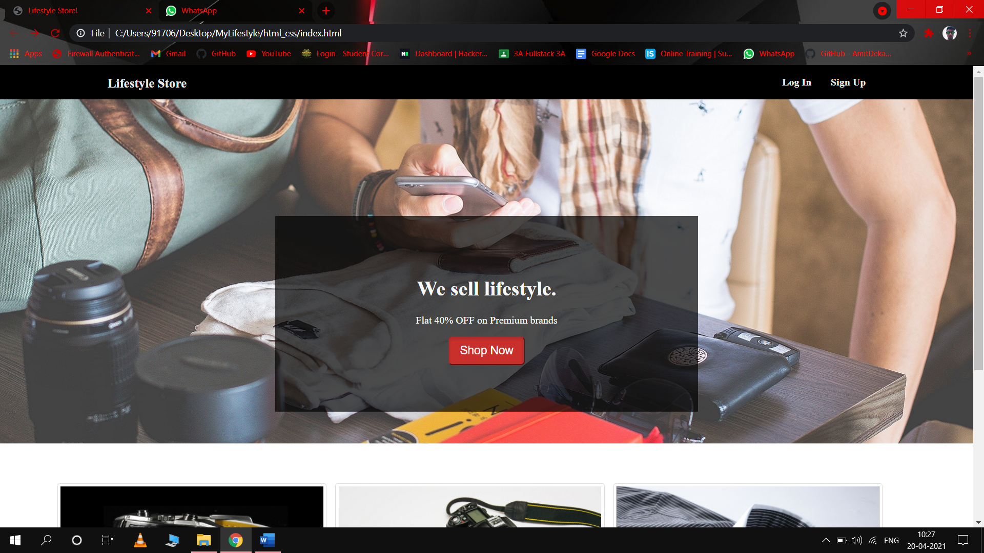

Slide 11
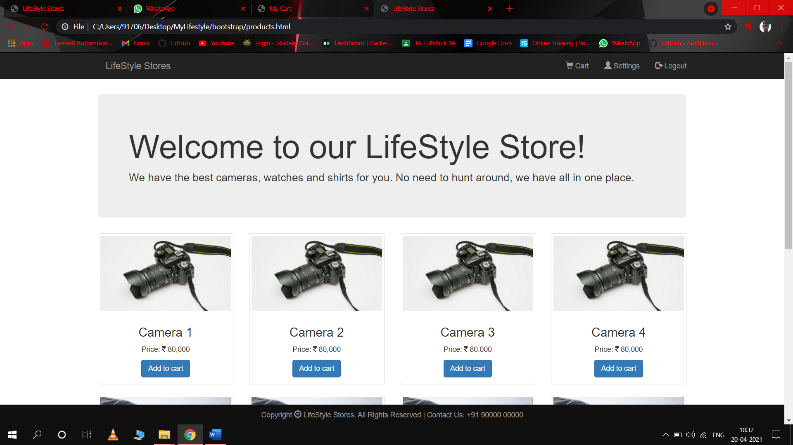

Slide 12
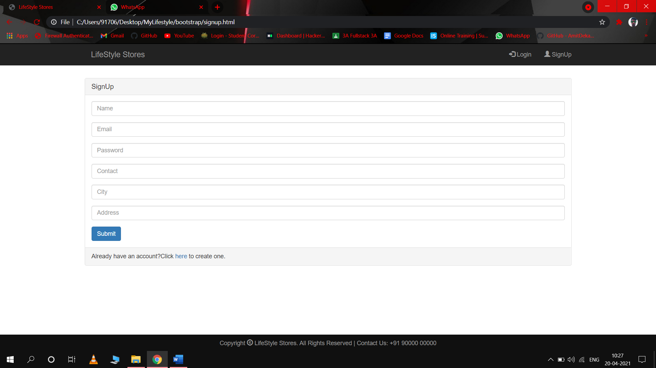

Slide 13
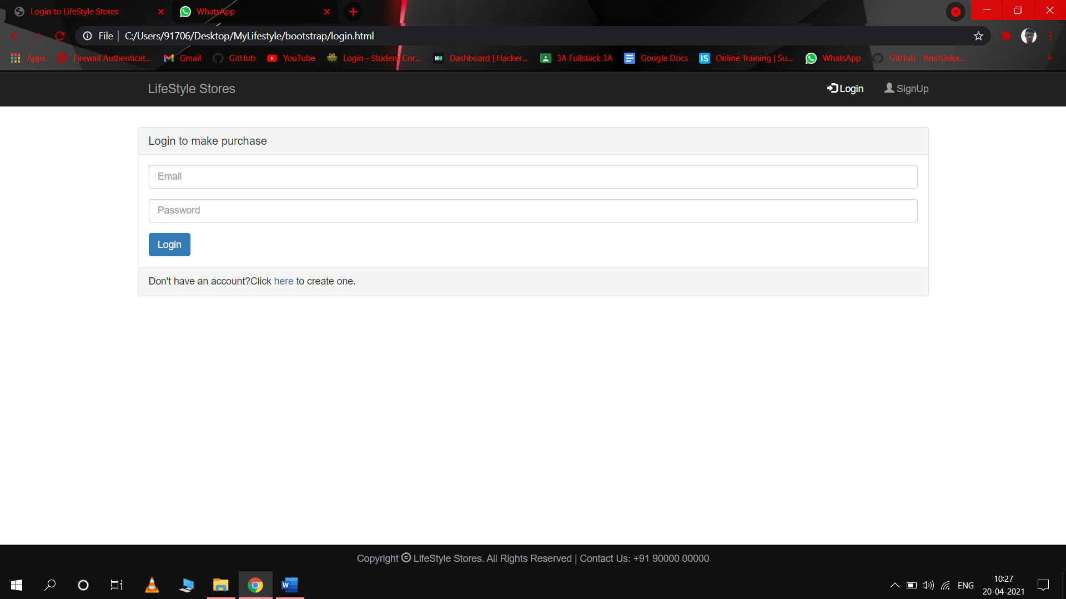

Slide 14
Few Limitations
You must need a Local server for storing the database at the backend.
People who are not familiar with computers or using online websites can’t use this software
There is always a scope of improvement in the software so in this also, like we will like to improve its user interface, add more features e.t.c.

Slide 15
Thank
You…

